Slide 1

AI-Powered Early Disease Detection for Rural Healthcare
Revolutionizing rural healthcare through AI and mobile diagnostics. Our solution bridges the gap between advanced medical technology and underserved communities, promising a future where timely diagnosis saves lives.

Slide 2
Rural Healthcare Challenges
Limited Diagnostics
Specialist Shortage
Increased Mortality
Rural areas lack advanced diagnostic tools, leading to delayed or missed diagnoses.
Few specialized healthcare workers choose to practice in remote, rural locations.
Delayed diagnoses in rural areas significantly increase mortality rates for treatable conditions.

Slide 3
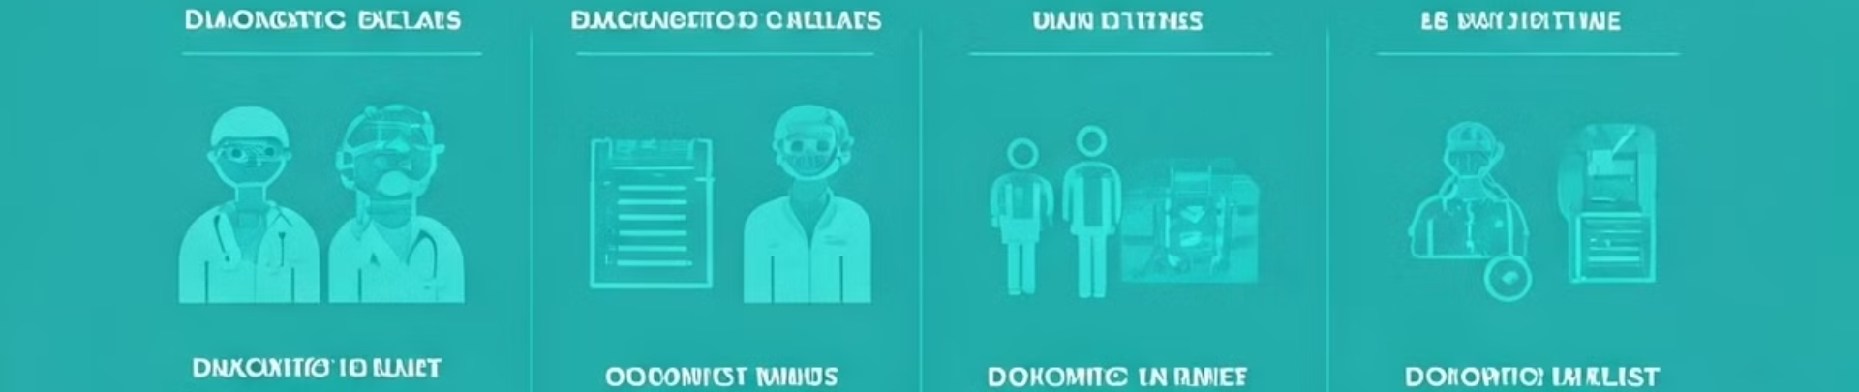
Impact of Diagnostic Delays
Rural Population at Risk
Critical Condition Delays
Mortality Impact
Delayed diagnoses increase mortality rates by 30% in rural communities.
45% of rural inhabitants lack access to timely medical diagnosis.
Average delay in diagnosing critical conditions in rural areas: 3.5 weeks.

Slide 4




Our Solution: AI-Powered Early Disease Detection
AI Triage
Mobile Diagnostics
Telemedicine
Advanced algorithms analyze symptoms and prioritize cases efficiently.
Portable units bring cutting-edge medical technology to remote areas.
Connect rural patients with urban specialists for expert consultations.

Slide 5
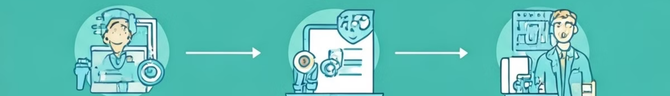
How It Works: End-to-End Solution Flow
1
Mobile Diagnostics
Portable units collect patient data and samples in rural areas.
2
AI-powered Triage
Machine learning algorithms analyze data to identify potential health risks.
3
Telemedicine Consultation
AI connects critical cases with urban specialists for immediate review.
4
Priority Queue Management
Patients are efficiently prioritized based on AI-determined urgency levels.

Slide 6





Technologies Behind the Solution
AI/ML
TensorFlow and PyTorch power our advanced disease detection models.
Cloud Platforms
AWS and Google Cloud ensure scalable, reliable data processing and storage.
Mobile & IoT
Custom-built mobile diagnostic tools integrate seamlessly with our AI system.
Telemedicine
Node.js and React.js create a smooth, responsive telemedicine interface.

Slide 7

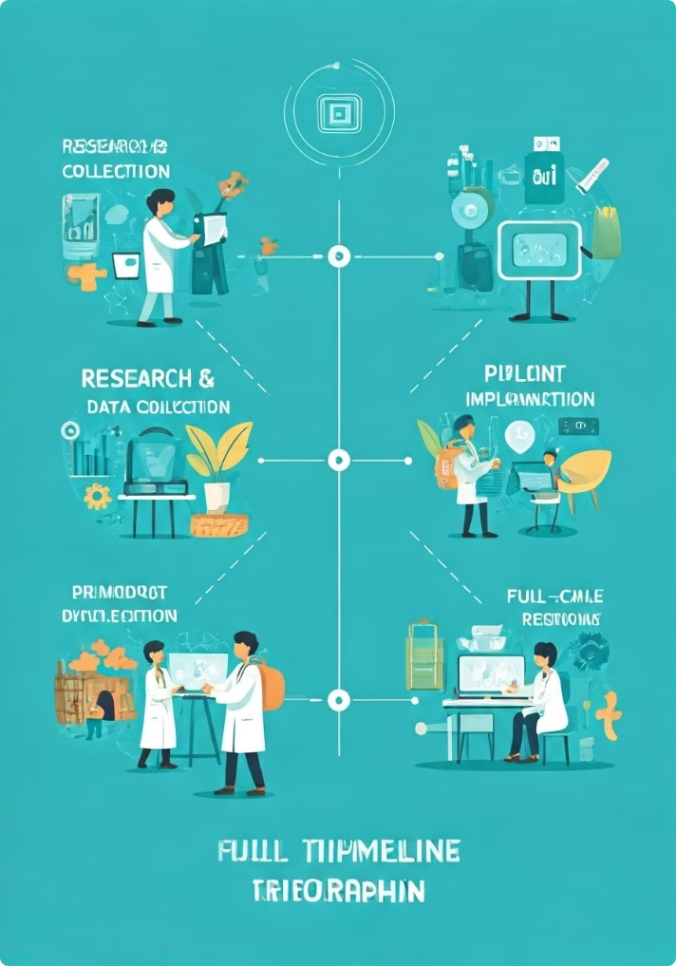
Implementation Roadmap
1
Research & Data Collection
Gather extensive medical data to train our AI models effectively.
2
AI Model Development
Create and refine AI algorithms for accurate disease detection and triage.
3
Pilot Testing
Deploy solution in select rural areas to validate effectiveness and gather feedback.
4
Full-scale Implementation
Roll out the complete system across multiple rural regions.

Slide 8

The Impact on Rural Healthcare
1
Faster Diagnosis
2
Specialist Access
3
Efficient Prioritization
Reduce diagnostic delays by 70%, leading to earlier treatment and better outcomes.
Increase access to specialist care by 500% through AI-powered telemedicine.
Optimize patient care with AI triage, reducing critical case wait times by 60%.

Slide 9
Scalability & Future Vision
Wide Coverage
Disease Expansion
Sustainable Growth
Mobile units can serve vast rural areas, reaching previously inaccessible communities.
AI models can be trained to detect a growing range of diseases.
Low infrastructure needs allow for rapid, cost-effective scaling across regions.

Slide 10

Transforming Rural Healthcare with AI
Bridging the Gap
Lives Saved
Join the Revolution
Our solution dramatically reduces healthcare inequity between urban and rural areas.
Early detection and rapid treatment could save thousands of lives annually.
Be part of transforming rural healthcare. Together, we can make a difference.

